Slide 1
The Marvelous GrowBrain
Multi-platform, open-source environment. Empowers the individual to solve a range of food needs, extracting value from idle resources via the stigmergic power of social networking and ad-hoc horizontal networks.
or,
Garden Automation and Networking leveraged with Public Data and Social Media
“Teach him how to fish, and you feed him for a lifetime.”

Slide 2
Big Ideas & Key Points
Apply the Power and Novelty of Social Media to the Garden
Guides and Encourages First-Time Growers, Pushes Seasoned Growers to the Next Level
Control your Garden with One Box, Control that Box with your Phone
Connect and Organize your Efforts with “Grow Groups”
Grow your Own Food for the Rest of your Life, Save Money, Eat Better
Help Heal the Planet, Reduce your Current Footprint
End Food Hunger in your Community
Paradigm Shift, Consumers --> Producers

Slide 3
Main Components
GrowBrain - physical product:
Controls up to 8 different physical components of the Garden, such as Watering, Fans, Lights, CO2
Input Sensors – Collect data on temperature, humidity, soil moisture, CO2 levels, motion detection, webcam
Can be operated at the unit, or controlled by App or Website
Available in variety of sizes and functionality based on user need
Voltage control for 1 to 8 outlets
Many display options: Touchscreen, small LCD, HDMI monitor, or none at all (networked)
App – iPhone/Android/Web:
“Profile” page for each user - customizable, receives and displays data from GrowBrain, GoCode, etc. Issues commands to main unit through use of web server

Slide 4
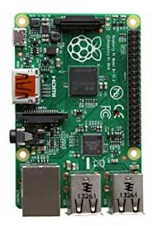
Raspberry Pi – key component, versatile
The Raspberry Pi 3 Model B+ is the latest product in the Raspberry Pi 3 range (various models, could use models specific to each type GrowBrain)
Broadcom BCM2837B0, Cortex-A53 (ARMv8) 64-bit SoC @ 1.4GHz
1GB LPDDR2 SDRAM
2.4GHz and 5GHz IEEE 802.11.b/g/n/ac wireless LAN, Bluetooth 4.2, BLE
Gigabit Ethernet over USB 2.0 (maximum throughput 300 Mbps)
Extended 40-pin GPIO header
Full-size HDMI
4 USB 2.0 ports
CSI camera port for connecting a Raspberry Pi camera
DSI display port for connecting a Raspberry Pi touchscreen display
4-pole stereo output and composite video port
Micro SD port for loading your operating system and storing data
5V/2.5A DC power input
Power-over-Ethernet (PoE) support (requires separate PoE HAT)

Slide 5
Raspberry Pi – Open Source Linux OS
Raspbian is the recommended operating system for normal use on a Raspberry Pi.
Raspbian is a free operating system based on Debian, optimized for the Raspberry Pi hardware. Raspbian comes with over 35,000 packages: precompiled software bundled in a nice format for easy installation on your Raspberry Pi.
Python is the programming language used to control the 40 GPIO pins, the central physical hardware feature.

Slide 6
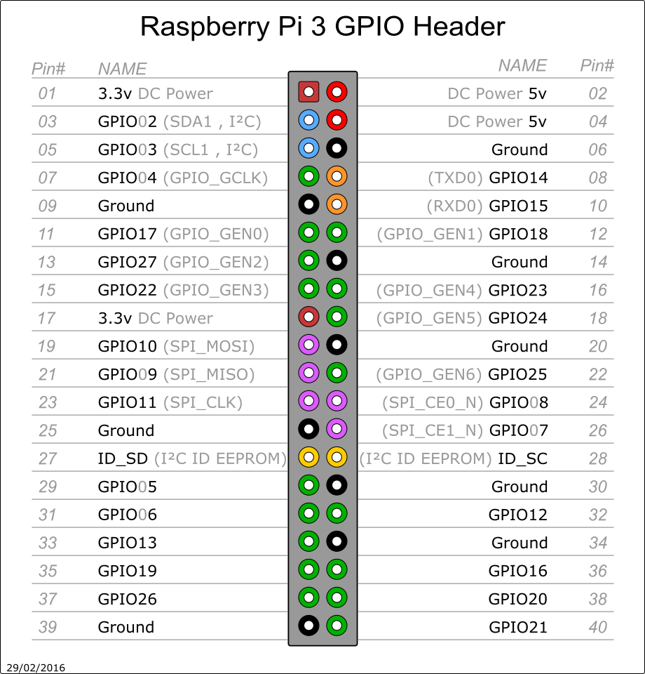
Raspberry Pi – GPIO Pins
GPIO: “General Purpose Input Output”
Can be programmed to receive input signals from a variety of sensors and accessories
Can be programmed to output 3.3v DC based on virtually any event imaginable

Slide 7
Common Features
USB Wireless Keyboard / Mouse pad – Logitech
HDMI out for external display
Touchscreen Available
No display needed if App / Web server is robust enough
Could be an issue in poor or no internet environments
Ethernet connect to laptop for Secure Shell (ssh) control
Basic computing functions, Internet, Email, “Office” suite
Waterproof options for remote greenhouse / outdoor environment

Slide 8
Common Features
Receive Text or Email alert if power is interrupted (as long as User has GrowBrain connected to server, app, etc)
Auto-Run programs on boot-up – with or without internet
To mitigate power failures/interruptions while no one is monitoring; nighttime, power company actions, storms, etc.
Can set a default state program to run if the unit loses power and comes back on. Program can then be manually exited to the Raspberry Pi LXDE
For Users focused mostly on the GPIO control benefit and ease of use
USB chargers for cell phones, small devices
Audio output for alert functionality

Slide 9
GUI / Social Media Environment
Each User creates a profile page with basic control panel GUI
To launch and run programs – watering control, fan control, drain pumps, CO2 control
Display input sensor data – User-chosen GoCode Data Set APIs, Webcam, Temperature, Humidity, Soil Moisture, GPIO Outlet On/Off States
Garden Profile – User fills in descriptor fields – soil type, size, nutrient types, feeding schedule, etc. – in order to provide analysis, encourage improvement
Photo / Video upload
User’s Public Data Page – customizable, uploadable, Variables: temperature, humidity, CO2, etc. Blog, Photos, Videos

Slide 10
GUI / Social Media Environment
The App will offer all of the most popular Social Media APIs to post Garden related status updates, photos, etc. connecting those viewers to our user’s Public Profile page
Discussion Groups / Boards
Public and Private, User-generated groups as well as GrowBrain Admins
Content –user and group generated blogs, tutorials, suggested templates
GrowBrain Python files downloadable, shareable
Direct Messaging

Slide 11
GUI / Social Media Environment
Supplies Tab – Users in groups can share common supplies
Identify common inputs – Soil, Peat Moss, Mineral Amendments, Earthworm Castings, Seed Meals, Pest Management Sprays, empty pots, light bulbs, fans, water, etc.
Purchase in bulk, save money
Ex. Buildasoil.com – integrated, shopping cart created that takes you to buildasoil.com
Divide up goods between members at point of purchase/delivery
Or, users plan storage at central convenient location
GrowBrain tracks inventory for all group users to view and edit
Helps new growers avoid common issue of forgetting/ running out of inputs
Groups can decide how to pay for expenses, plan and save
Could help form equity structures in commercial groups
Blockchain tech for non-local groups

Slide 12
GUI / Social Media Environment
Learning Tab: Content, Content, Content
CSU Master Gardener File
Every GrowBrain comes preloaded with the entire 700 page set of CMG Garden Notes from Colorado State’s Master Gardener Curriculum.
Consider a link to each specific file, as well as full file
BuildASoil.com
Current and past tutorials
Integrated hopefully as inventory supplier
GrowBrain Content
Help File on every unit, specific to customization
Python Programs to download and use
Suggested templates/ methods for specific set-ups, crop types
User Generated Discussion Boards
Group boards, individual boards,

Slide 13
GUI / Social Media Environment
Harvest Tab :
Users can input their harvest yields to track results
Coops track and plan progress, move to next step of delivery or storage
Post achievements and progress updates to Social Media
Identify and analyze low yield harvests, find out why
Users can publicly post inventories available for sale, facilitating market conditions

Slide 14
GUI / Social Media Environment
Air-gapped (stand-alone) units
No data connection whatsoever (user can always add later)
For those concerned with data security or in remote situations no internet
Same Profile GUI page
Come loaded with programs, content (can add more via USB or flash drive)
Social Media function not available
Will need external storage for anything other than GPIO data (large files like photos/videos)

Slide 15
GoCode Data Sets
Food Deserts – census tracts more than one mile from a grocery store
http://codataengine.org/find/food-deserts-metro-denver-region-2009
Areas where adults ate vegetables less than once per day
http://codataengine.org/find/colorado-states-percent-adults-consuming-vegetables-less-once-day-2011
Noxious Weeds, areas that may be getting sprayed
https://data.colorado.gov/Environment/Noxious-Weeds-in-Colorado-2014/mguq-rjzb
Soil Districts of Colorado
https://data.colorado.gov/Local-Aggregation/Soil-Districts-in-Colorado/fwb5-rzg5
Average Sunlight Levels
https://data.colorado.gov/Energy/Solar-Direct-Normal-Irradiance-in-Colorado-2014/unz2-68bn

Slide 16
GoCode Data Sets
Rain, Hail and Snow, 1999-2015 – view historical trends, compare with current temps pulled from other APIs
https://data.colorado.gov/Environment/Rain-Hail-and-Snow-in-Colorado-2015/mqid-8hv2
Road Conditions – Real time for daily use, shows traffic, dangerous conditions, closings, etc
https://data.colorado.gov/Transportation/CDOT-Real-Time-Data-Feed-XML-/j3ch-zsvz
Users can monitor current water levels and quality, plan for droughts
https://data.colorado.gov/Water/DWR-Current-Surface-Water-Conditions/4yw9-a5y6
Monitor Well Water levels, identify dry areas
https://data.colorado.gov/Water/DWR-Well-Water-Level/hfwh-wsgi

Slide 17
GoCode Data Sets
Real Time Weather Data
BBB – Business locate data
Webcams – ask data team (josh)
For security
For intelligent monitoring

Slide 18
Pictures of App Screens

Slide 19
Similar Apps / Competition
Grow It – social aspect, find businesses, huge database of plant info
3 out of 5 Stars, seems buggy
Possibly integrate?
The Greenery – local Durango garden
Uses a similar hardware version made using Windows, not an app. Custom hardware built specifically for their sole use.

Slide 20
Who Are The Users?

Slide 21
Traditional Users
Home Gardeners
Commercial Gardeners
(These two groups may start to blend!)
New Users
Grow-Ops (The Co-op Reimagined!)
Charities (Crowd sourced, non-local, networked)
Schools (Ag Science classes, labs, raspberrypi.org)
Commons (Publicly owned gardens)
Intentional Communities (Ridgway, CO)
Human Development (Spiritual Retreats)

Slide 22
Turning Consumers into Producers
Hobbyists, part-timers, half-committed growers – all transformed into serious yield producers
Idle grass yards become life sustaining gardens (networked gardens coordinated neighborhood gardens)
Social Profile (Grofile!?), integrates with social media. Novelty of posting about your garden. Organizes the process more fully. Creates shared culture
Teaches the User basics of growing, social aspect creates a learning community and encourages growth, data tracking reinforces skills
Jobs and/or food security for retiring Baby Boomer segment
Creates conditions favorable to local farmers markets

Slide 23
Commercial Growers gain Professional Edge
Full Automation, precise control over all variables
Data logging on all variables to review and refine processes.
Excel-compatible exports and customized reporting for all variables
Push notifications via text or email, set for any variable, any value
View and control multiple units via smartphone or website
Networking, vertical integration / partnerships with peers, subsidiaries, supply chain management, coordinate multiple facilities
Open Source software / Air-gap functionality – sensitive data secure
Reprogrammable for future changes – facility upgrades, crop type/configurations

Slide 24
“Grow-Op” – The Co-Op Reimagined
Traditional Co-Op garden, split up over members’ spaces. Each group can plan and manage itself on the group page, can see each others gardens’ data, photos, videos, etc. Tracks the progress of the group, creates a shared experience. Users can help each other with GrowBrain settings as well as general growing advice.
Supports local Farmers’ Markets, could create new ones
People can contribute in small amount that is manageable – wide net
“Disadvantaged” low-income families - creates support networks, provides work for those looking

Slide 25
Food Banks / Charities
Churches throughout area can coordinate together for large food drive events – Holidays, etc.
Charities could be created solely to do this in areas of need
Leverage social media to gain recruits
“Shelper” app from 2017
A platform to connect homeless shelters and community organizers with homeless clients through consolidation/aggregation of info for homeless shelter volunteers and caseworkers.

Slide 26
Schools
Could create Lab study or class on homesteading
Combines computing with traditional ag science
Introduce students to gardening
Classroom gardens managed and analyzed for educating

Slide 27
The Commons
For Progressives, Futurists, Syndicalists, Socialists, Communists, Libertarians, Anarchists, Voluntarists, and any other –ists
A commonly-owned garden can be managed by the group with equal access and control
Blockchain (Bitcoin, Etherium, any good Proof-of-Work algorithm)
256-bit SHA Cryptography provides true counterparty risk management, transparency.
Basically a public ledger of everyone’s log-ins, changes to the GrowBrain, contributions, notes, etc. So there doesn’t have to be a boss ☺
Stops working if quantum computers happen…

Slide 28
Intentional Communities
Tiny Home Communities / RV Parks
Individual gardens networked, or a single community garden
Communal or Co-living neighborhoods
Alpinglow, Ridgway CO: https://alpenglowcohousing.org/welcome/

Slide 29
Human Development
Spiritual Retreats
Connect with nature by learning how to garden or simply doing garden work as a meditation, karmic yoga
Attendees grow, prepare, store, and eat from the same garden – intentional work with direct beneficial experience
In addition to any other specific spiritual practices
Garden Retreats
Learn how to build and operate a proper-sized garden that fits your lifestyle
GrowBrain is key in motivating and supporting these new growers

Slide 30
Complementary Past GoCode Projects
Shelper – by paulogleuwyo
https://github.com/GoCodeColorado/Shelper
A platform to connect homeless shelters and community organizers with homeless clients through consolidation/aggregation of info for homeless shelter volunteers and caseworkers
FarmToTable - by nerboda
https://github.com/GoCodeColorado/FarmToTable
Dating site for farms and restaurants (A relationship with your food)

Slide 31
Complementary Past GoCode Projects
The Leroy Jenkins Project – by vicrumnaug
https://github.com/GoCodeColorado/TheLeroyJenkinsProject
Empower farmers by connecting them to Coloradans and businesses through farmers markets
Lovacore – by paultr
https://github.com/GoCodeColorado/Locavore
Providing people access to healthy and affordable food from local farms using USDA food deserts and Yelp API for grocery stores and other food locations.

Slide 32
Future Implications
Food Drops as a Percentage of Household Expenses
As Traditional Work Fades, Food Security Escapes the Cash Nexus
Network of Food Providers Strengthens Local Resilience
Community Health Improves
Greening of the Environment
Empower the Individual to Empower the Whole

